Slide 1
ML Meeting: 15/09 2022
Sjur Beyer

Slide 2
Purpose
Demonstrate the infrastructure
Performance evaluation
Statistics
Visual comparison
Model storage
Transfer learning methodology

Slide 3

How far did I get?
Implemented all needed architectures
Implemented transfer learning loss functions
Implemented logging script
Gotten familiar with loading the data from NGI’s TNW folder (OpendTect etc.)
Ran at least one algorithm with summary statistics
Added:
Export env yaml before first run, and keep it up to date
Discussed ML approach with a friend who is experienced with ML
A bunch of reading; Added a lot of papers to my Zotero
Found something interesting for Guillaume on Seismic inversion

Slide 4
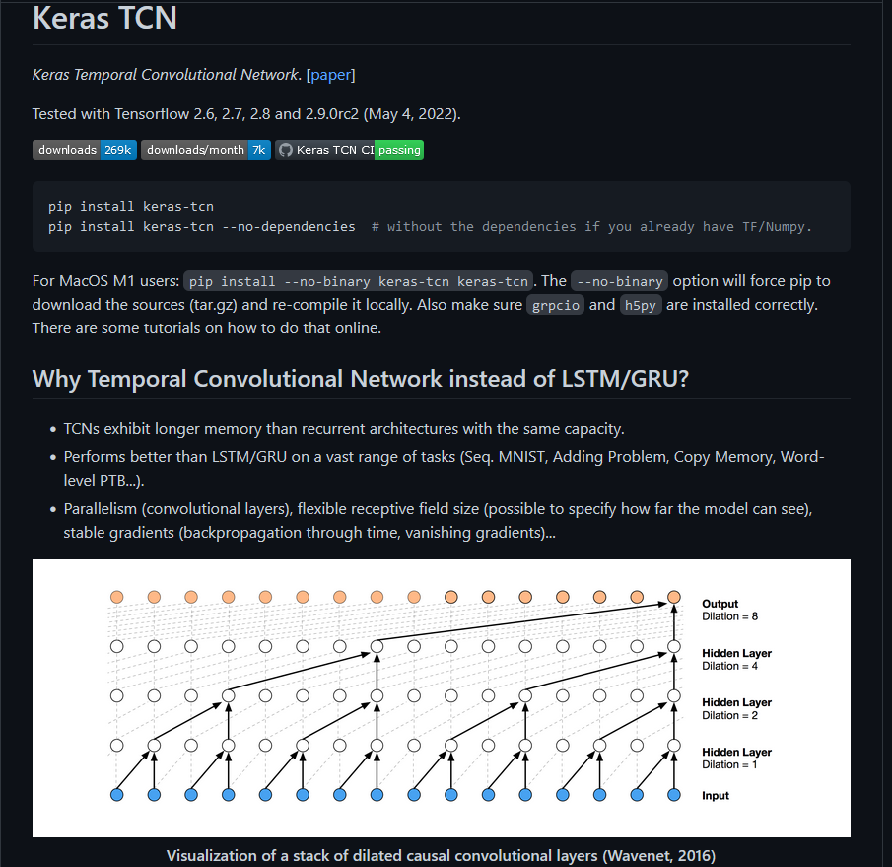
Implementation inspiration
I was able to look to this repo for inspiration:
https://github.com/philipperemy/keras-tcn
I still wanted to have had a hand in the implementation, because this network is not specialized for seismic.
Implemented line by line; added 2D compatibility

Slide 5
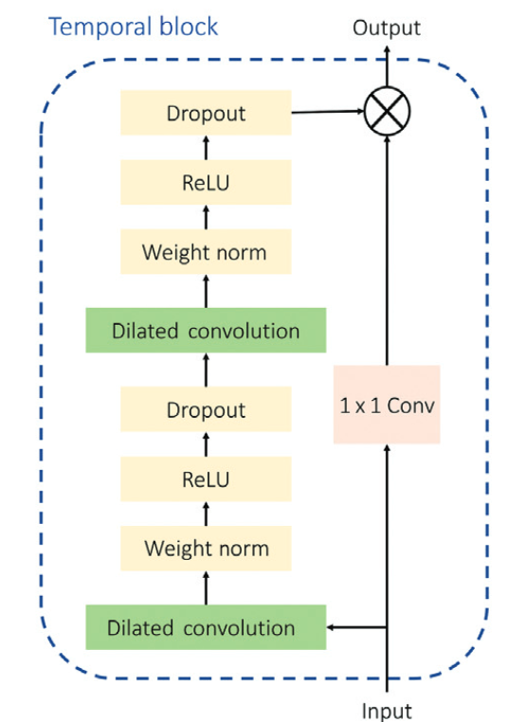

Permutation ideas
Testing out the different normalizations might be a good idea.
Optuna might be a good option to tweak the ML hyperparameters
Layer norm
Layer norm

Slide 6
Infrastructure
Goal: Make it as forwards-compatible and robust as possible
I want to have a good enough infrastructure, so that I will not have to make grand changes in the future, which will leave older models non compatible with newer ones
This affects:
How the architectures are set up
Implementing new architectures should not be harder than just writing one new function
Running different set ups, data sets, dilation rates etc. should not need coding specific to the training instance
2DTCN should handle to be passed 1DTCN parameters and vice versa. Random forest should know to ignore TCN params
Writing the instructions for trying out different permutations of model parameters should be very easy to do

Slide 7
config.JSON and other files
‘config’ : dict
Contains the settings used for that particular model
‘summary_stats’ : dict
Contains the summary statistics for the model and performance evaluation
‘data’ : list
Contains file paths to the data used for training (maybe also testing) the model
In this way, augmented data sets can be created without getting tied to a particular model instance
These may be joined in a common JSON file belonging to each model instance log as well

Slide 8
Permutation script
Some combinations will be more intersting than others
With a control JSON script that can be edited to alter the model parameters, this makes it easier to test out different configuration permutations
However, there needs to be a script that instructs the testing of these permutations in a good way.

Slide 9

Performance evaluation
At least in the beginning, it can’t hurt to export many different statistics
Using the same ones that NGI used for TNW will at least make for good model comparisons
Cross validation
MAE, Accuracy
$(\hat{x}−x)/x$
Acoustic impedance inversion can be tested on a larger data set.
May use some covariance statistics combined with the AI inversion?

Slide 10
Visual comparisons - Images
To see if the model can capture the features properly, there should be written a script that creates an image containing the input seismic features, and reconstructed features
Python implementation for this; else -> Postscript
Also the predicted values vs the true values, maybe displaying the prediction error
Using the acoustic impedance, it is possible to get a overlay heat map, which displays what areas the model encounters issues in the most
Can see if the same thing appear with a different noise profile or denoising

Slide 11
Storing the models
Functions for this is located in \Scripts\Log.py
Models get stored in the \Models folder
New ran models are categorized in folders by datetime
That way, all models will have unique names; Maybe I should create a UID
In the folder will be a JSON file containing the parameters used for the model
There should be a JSON containing summary statistics, and potentially which synthetic data were used
In the folder will also be a folder (or something else, pickle?) containing the weights
There should also be a folder for visual comparison images (only of certain quantile performance error)
I’ll write a function which makes it easy to load the keras object for further prediction

Slide 12
Transfer learning
The three best predicting models can be kept track of, and when training new models the weights may be initiated 1. Randomly, 2. Using feature extraction module from the other best performing models.
If the model then performs even better, It will replace one of the others on the top three list
Overfitting may cause issues with this
Another option: Using monte carlo tree search based on all other models
May be problematic to add new models to the pool

Slide 13
What to run?
This is about navigating the different permutations of model setups
For all combinations of ML parameters (e.g hyperparameter tweak, epochs, batches, learn rate etc. )
Initialize on the three best performing, and random
Try using boreholes only
Try handpicked traces, w/ genetic algorithm
Try 1D and 2D
Weight sharing – no weight sharing
Levels of random noise
Feature augmentation
Optuna hyperparameter tuning

Slide 14
Next meeting
General Meeting: 5/10 2022
There may be a meeting before this time as well
Until then:
(Get my head around shapes..)
Start to compare models, and present some preliminary results

